Slide 1
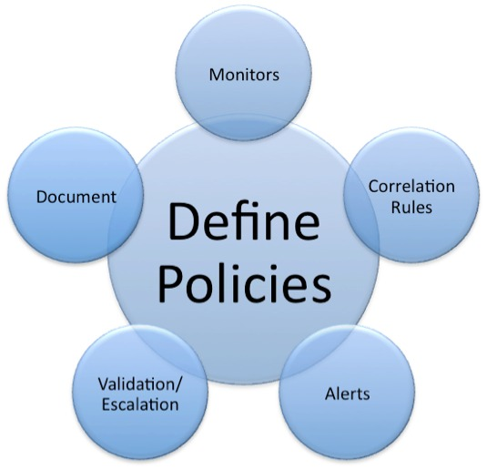
Security Policy

Slide 2

How does this relate to cybersecurity?

Slide 3
The AAC Issue
Awareness
Acceptance
Compliance
Policy acceptance – don’t use thumb drives that are found

Slide 4
LinkedIn Learning – Test Material
Security Policy video #1 – “Security policy framework”
Just section 2
https://www.linkedin.com/learning/cysa-plus-cert-prep-4-security-governance/security-policy-framework?autoplay=true&u=74650722

Slide 5
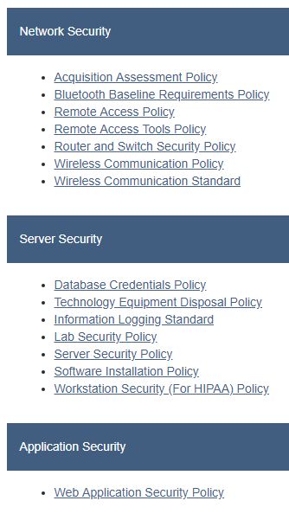
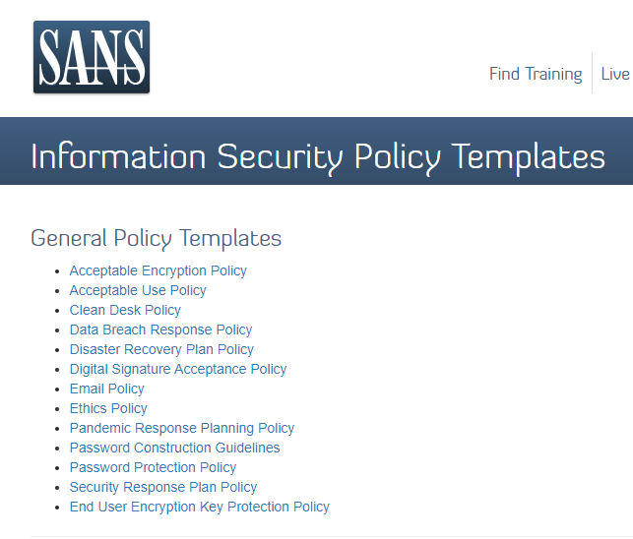
SANS Policies – Four Types
14
15
16
1
2
3
4
5
6
7
8
9
10
11
12
13
https://www.sans.org/security-resources/policies/general#acceptable-encryption-policy

Slide 6
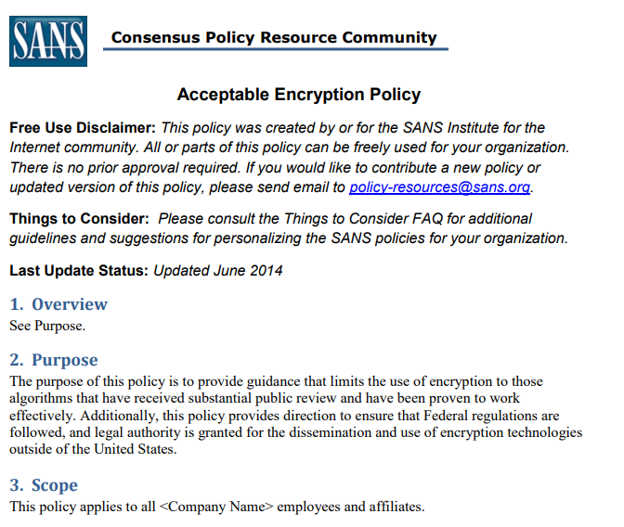
Sections of Each Policy

Slide 7
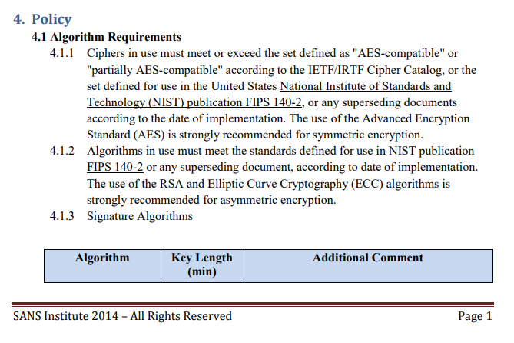

Slide 8
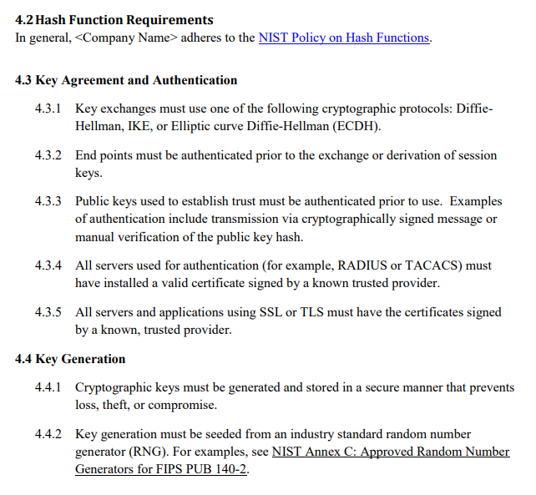

Slide 9
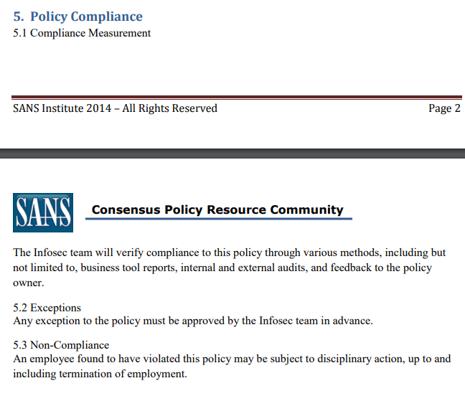

Slide 10
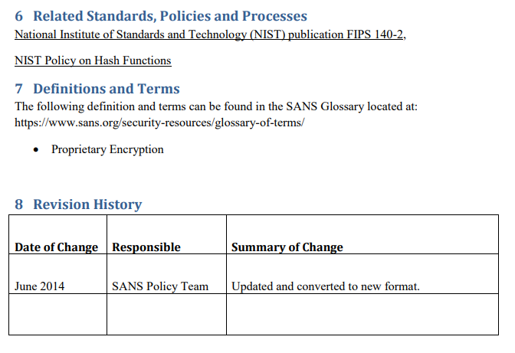

Slide 11
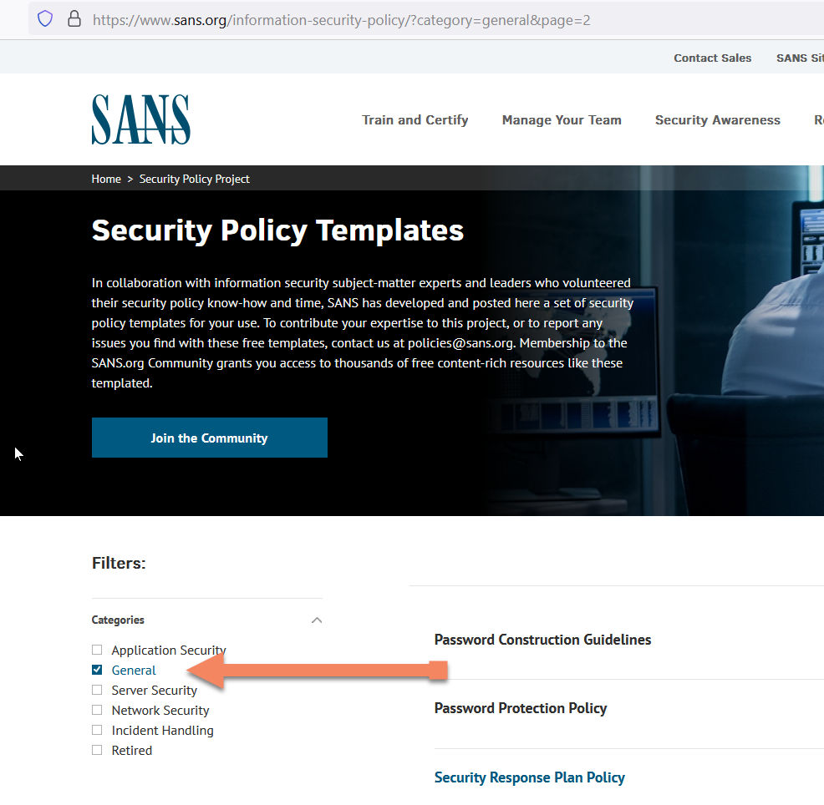
Exam – Know The 13 “General” Policies

Slide 12
Linkedin Example
https://www.linkedin.com/legal/privacy-policy

Slide 13
SANS Information Security Policy Templates “General” Policies

Slide 14
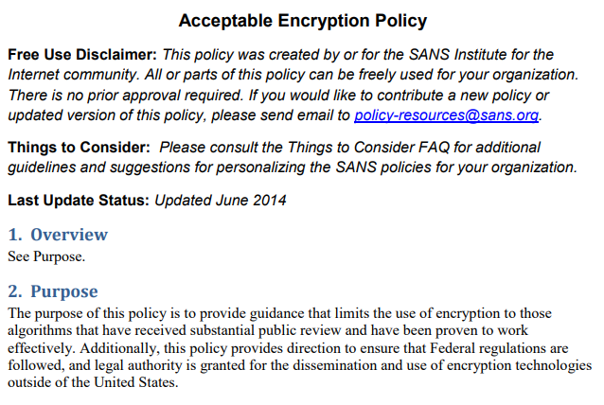

Slide 15
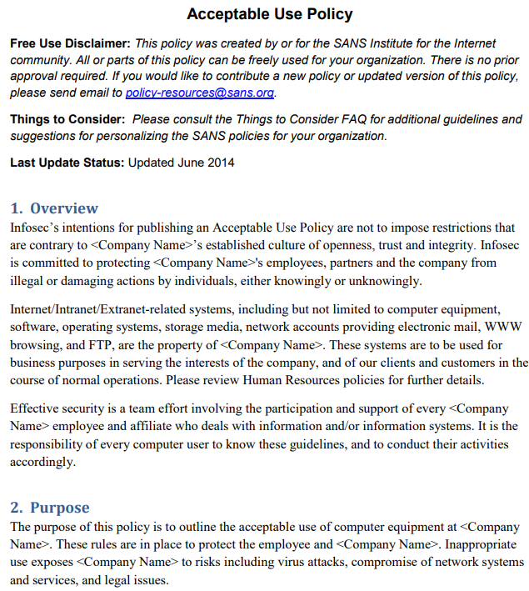

Slide 16
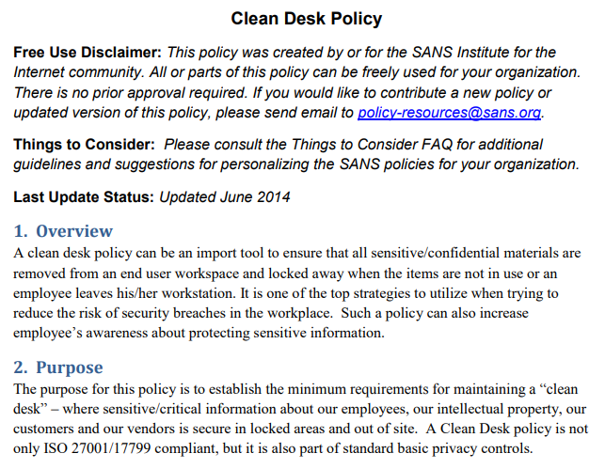

Slide 17
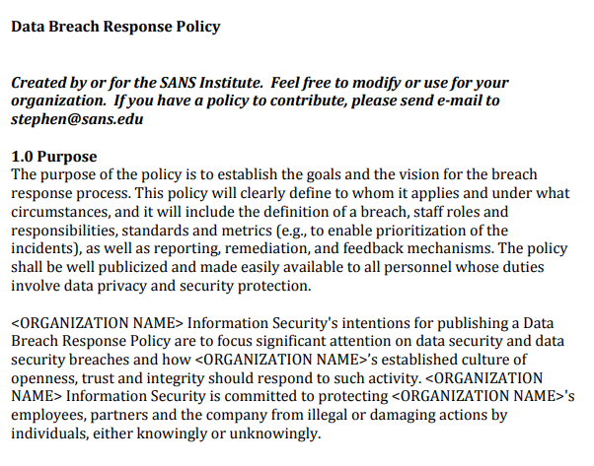

Slide 18
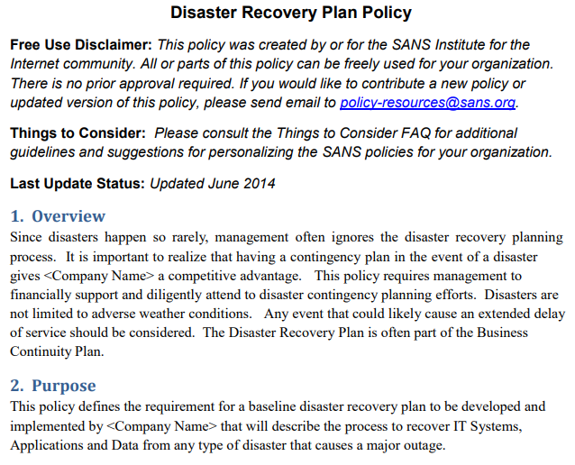

Slide 19
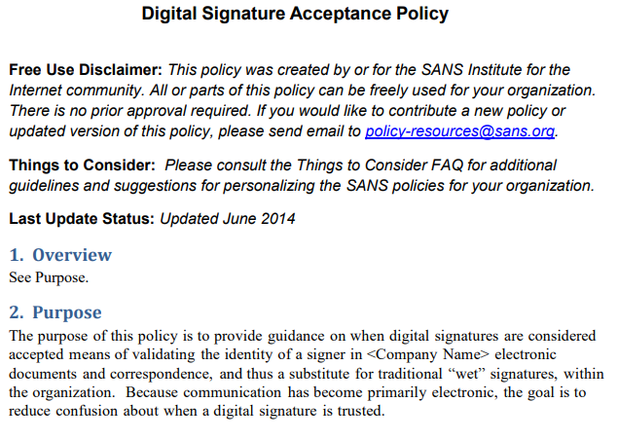

Slide 20
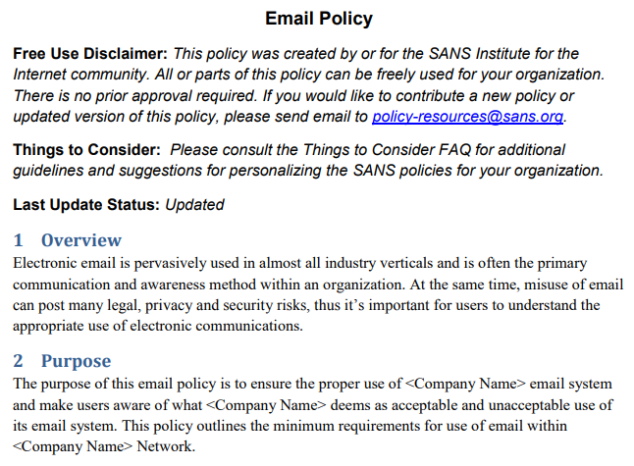

Slide 21
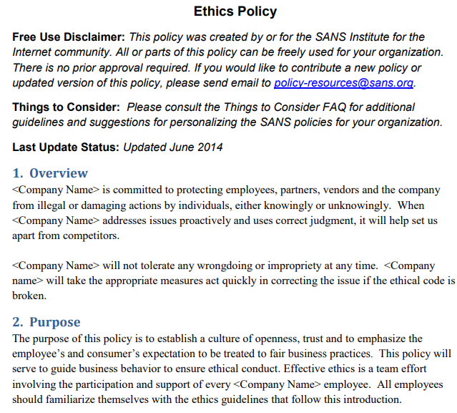

Slide 22
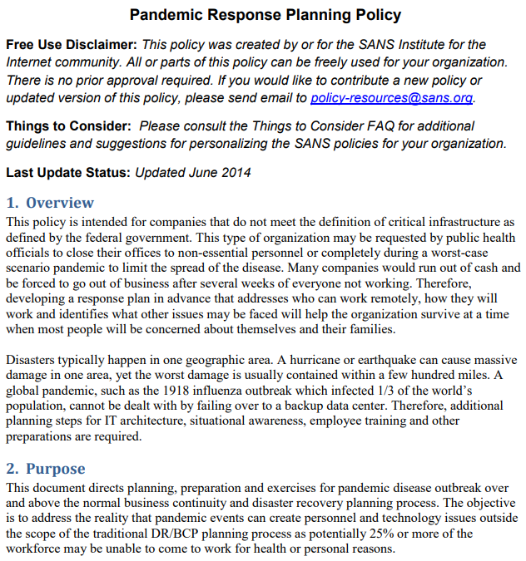

Slide 23
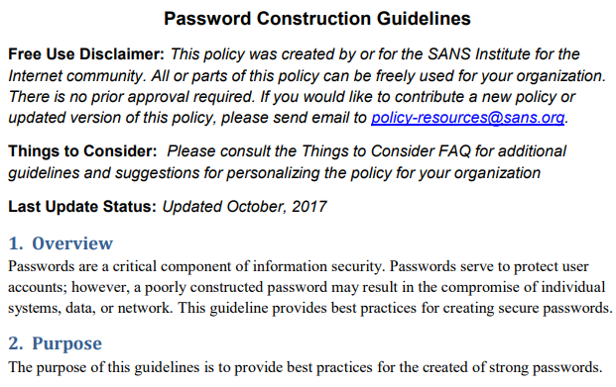

Slide 24
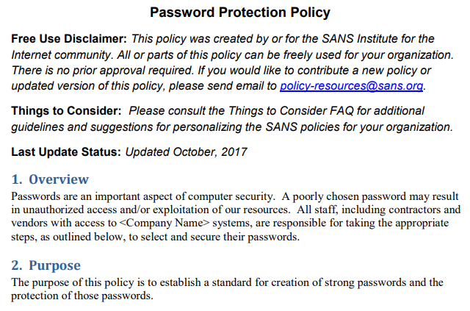

Slide 25
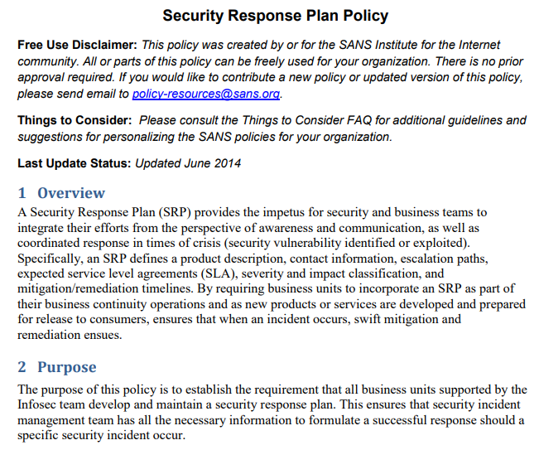

Slide 26
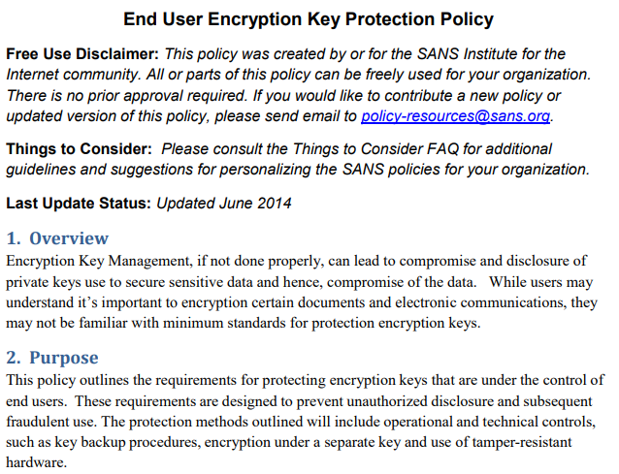

Slide 27
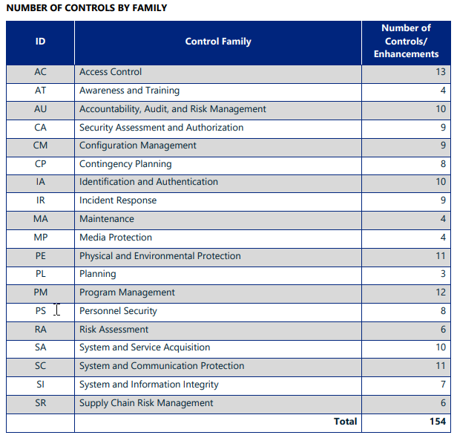
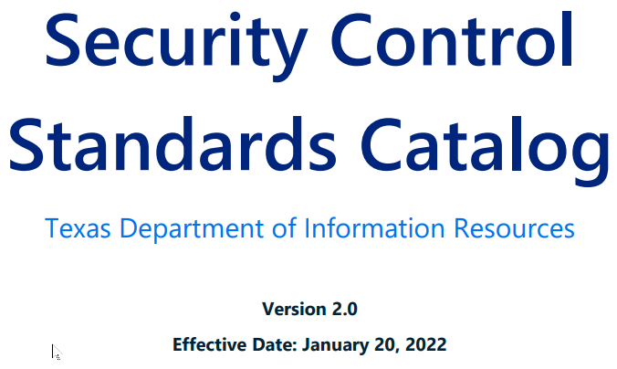

Slide 28
Purpose
The purpose of the Security Control Standards Catalog (catalog) is to provide Texas state agencies and institutions of higher education (subsequently referred to as state agencies) with specific guidance for implementing security controls in a format that easily aligns with the National Institute of Standards and Technology Special Publication 800-53 Revision 5 (NIST 800-53 Revision 5). Terms and definitions in this catalog are based on NIST, unless otherwise defined by Texas state statute, rules, or guidelines.

Slide 29
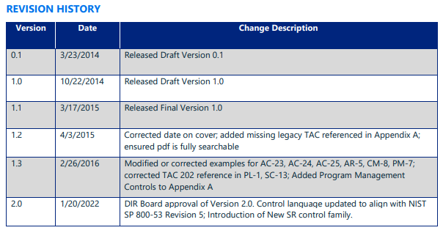

Slide 30
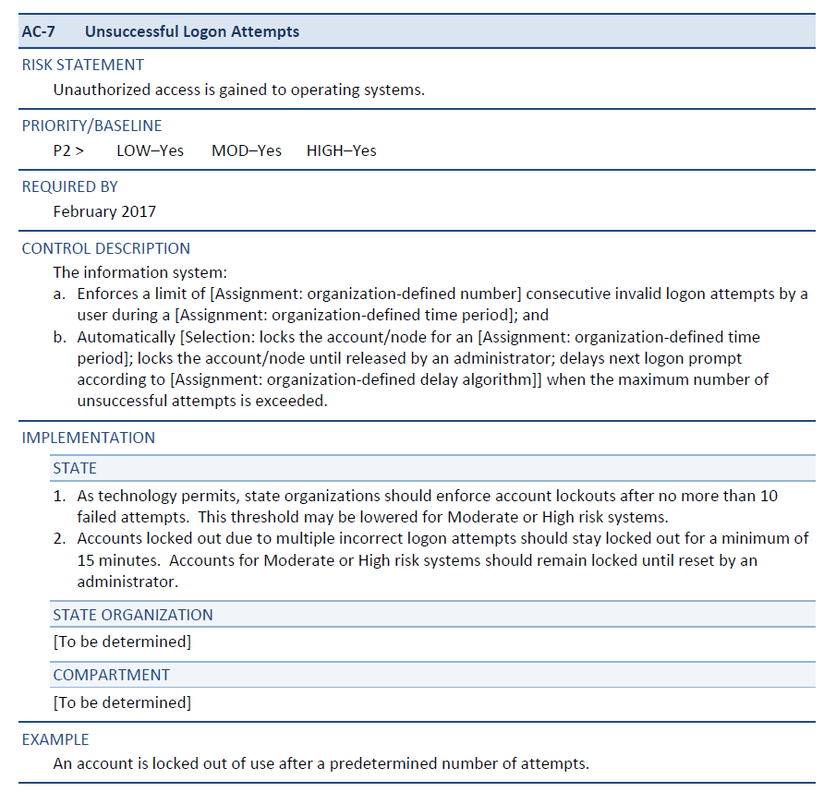
Example

Slide 31
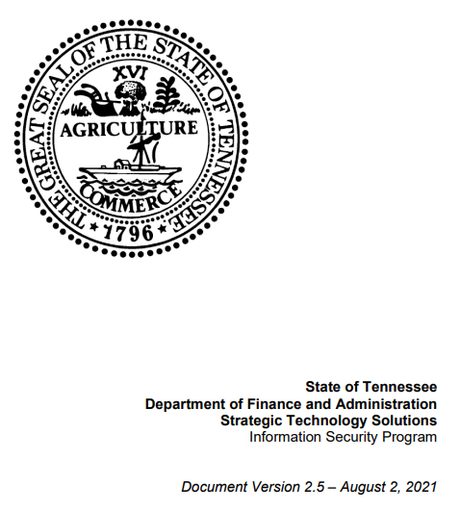

Slide 32
State of Tennessee Policy
The main purpose of this document is to define the information security policy of the State of Tennessee along with the organization and framework/structure required to communicate, implement, and support this policy. Information is an asset, which like any other asset owned by the State of Tennessee, has significant value to the stakeholders of the State. Information security is a critical component that is required to enable and ensure the confidentiality, integrity and availability of data, network and processing resources required for the State of Tennessee to perform its business and operational practices. This policy document has been created to establish and uphold the minimum requirements that are necessary to protect Information Technology (IT) resources (assets) against unavailability, unauthorized or unintentional access, modification, destruction, or disclosure as set forth by the Information Systems Council (ISC) of the State of Tennessee.

Slide 33
State of Tennessee Policy
This document applies to all full- and part-time employees of the State of Tennessee, all third parties, outsourced employees or vendors who work on State premises or remotely connect their computing platforms to the State of Tennessee’s computing platforms and any cloud provider storing, processing, or transmitting State data.

Slide 34
State of Tennessee Policy
The Enterprise Information Security Policy for the State of Tennessee is based on the International Standards Organization (ISO) 27000 series standard framework. This policy is designed to comply with applicable statutes and regulations; however, if there is a conflict, applicable statutes and regulations will take precedence. This policy defines the minimum requirements for providing a secure operational environment.

Slide 35
Link to the Policy
https://www.tn.gov/content/dam/tn/finance/sts/security-documents/300-POL-001_EISP-V%202.5%20Policy.pdf

